Slide 1

K-Means Clustering Analysis of Vehicle Fuel Type Correlations with Asthma Related Deaths in the Bay Area
By: Mihir Thakar
Notes:
Hey guys this is my presentation ‘title’ obviously that was a mouthful but I hope to give you a better understanding of what that actually means

Slide 2
Work Pipeline
Data Acquisition, Selection, and Cleaning
Data Exploration and Analysis
Data Visualization
Notes:
Wanted to give an overview of what my work pipeline was

Slide 3
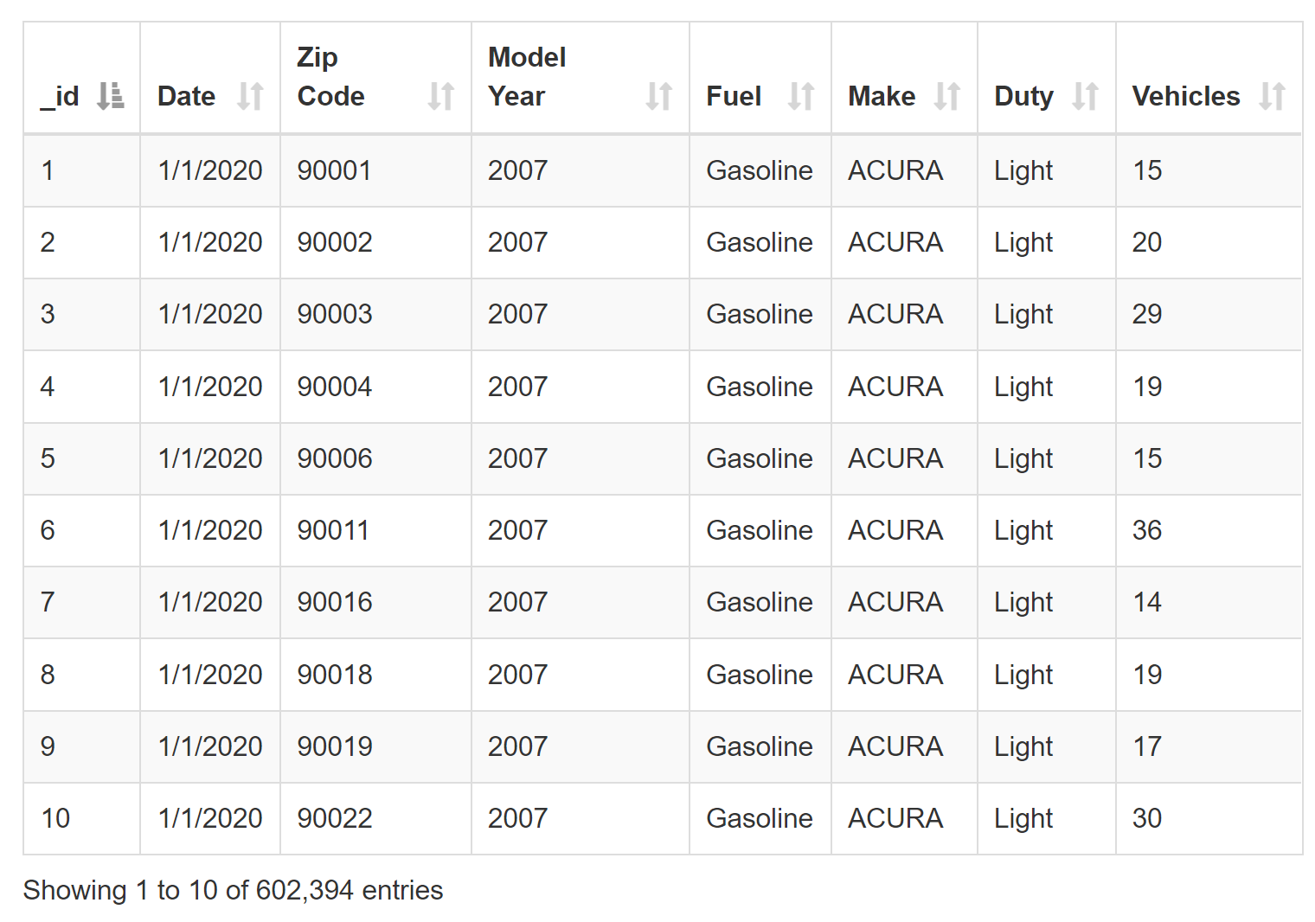
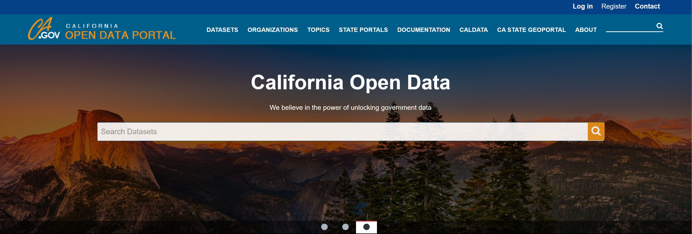
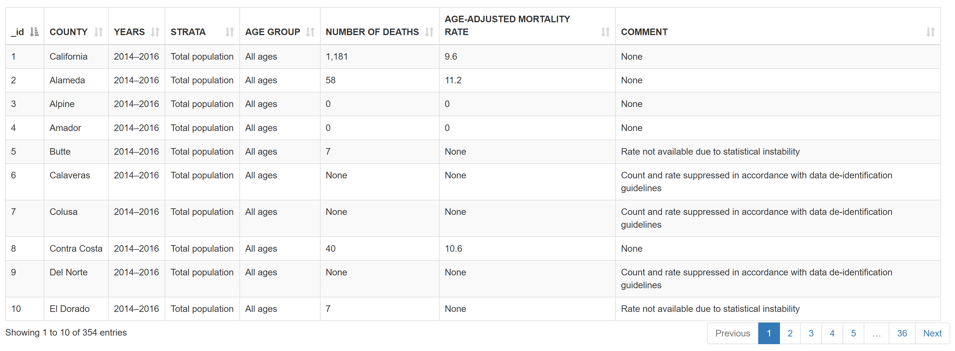
Datasets
Asthma Deaths by County
Vehicle Fuel Type Count by Zip Code
Notes:
Got my data from ca open data portal, it’s a pretty open source portal it has a wide variety of datasets not just related to the topic I chose but also public health, environmental, and government datasets
The two datasets I had were as follows
Obviously theres multiple zipcodes in a county so I needed a way to map those two together

Slide 4
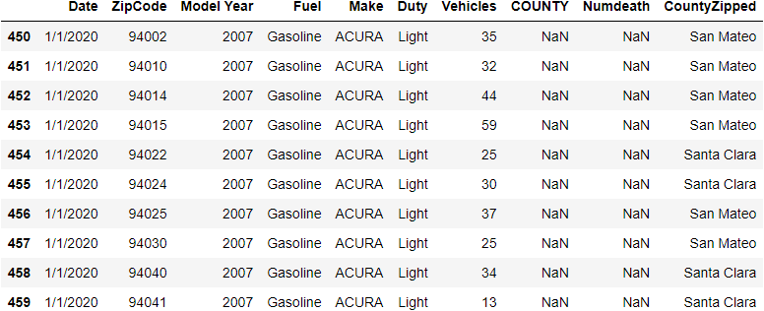
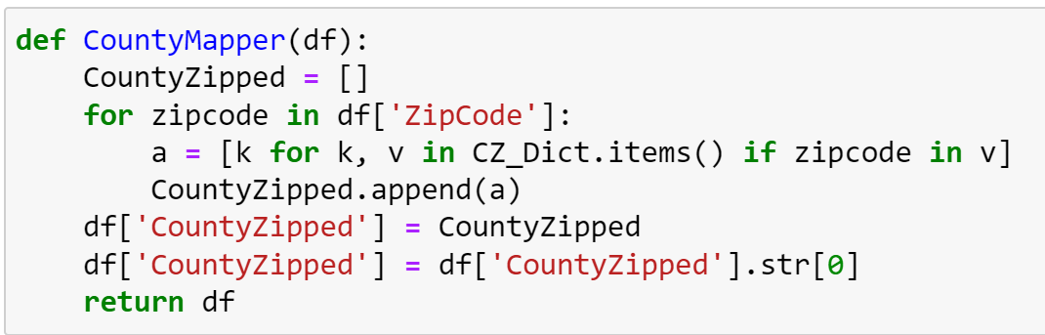
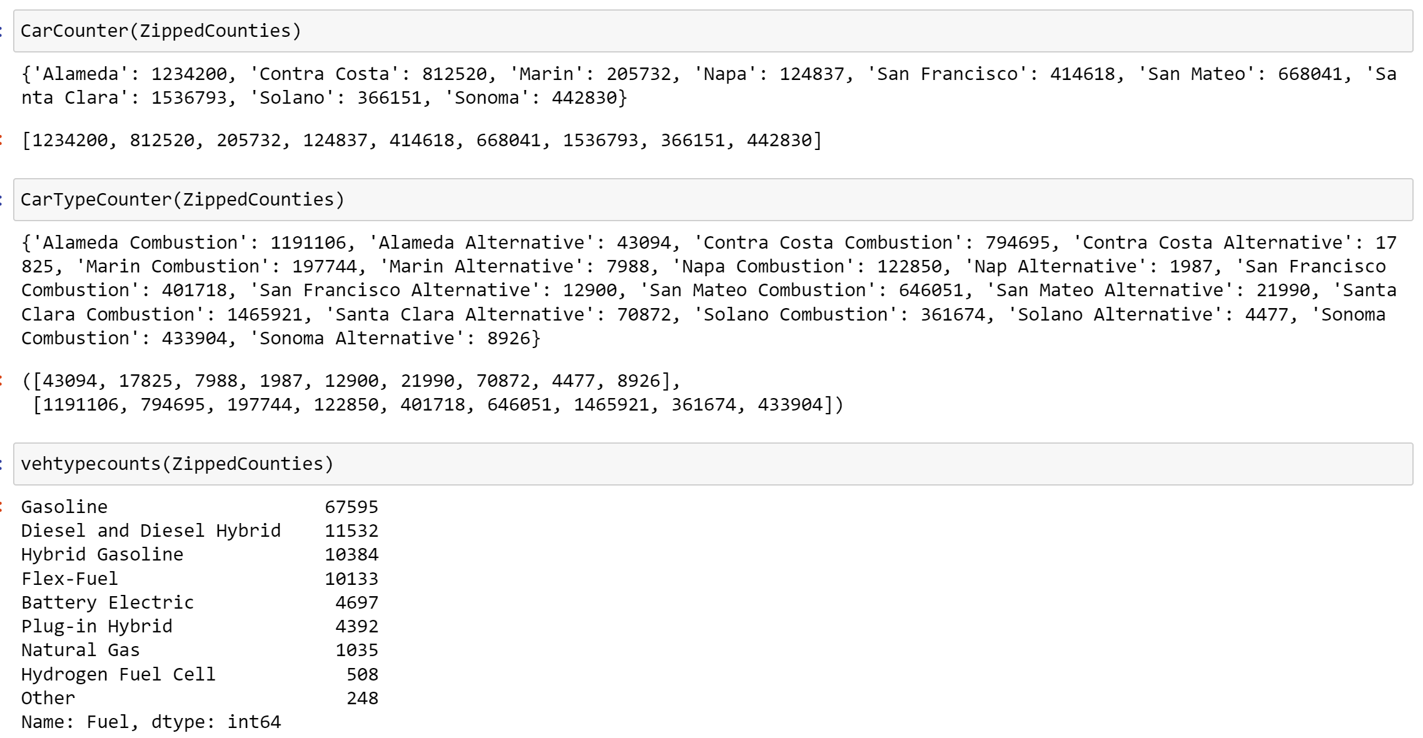
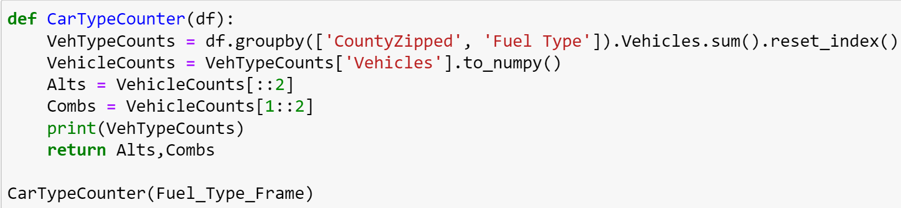
Data Cleaning Before
Functions:
CountyMapper: Maps each ZipCode in Fuel Dataset to it’s corresponding County
CarCounter: Counts the cars in each County
CarTypeCounter:
Combustion = ['Gasoline', 'Diesel and Diesel Hybrid', 'Hybrid Gasoline', 'Flex-Fuel', 'Natural Gas', 'Other’]
Alternative = ['Battery Electric', 'Plug-in Hybrid', 'Hydrogen Fuel Cell']
Notes:
So heres some of the functions I wrote that helped me clean the data, I had to hard code some preliminary data given that I was only studying the bay area so I had a dictionary of what zip codes belonged to what county. But I hope to practice some more webscraping to maybe create a California and ultimately a us map
Some of the important decisions I made was distinguishing fuel types these were the types there were and I actually put hybrid gas in combustion just bc it is a combustion engine still

Slide 5
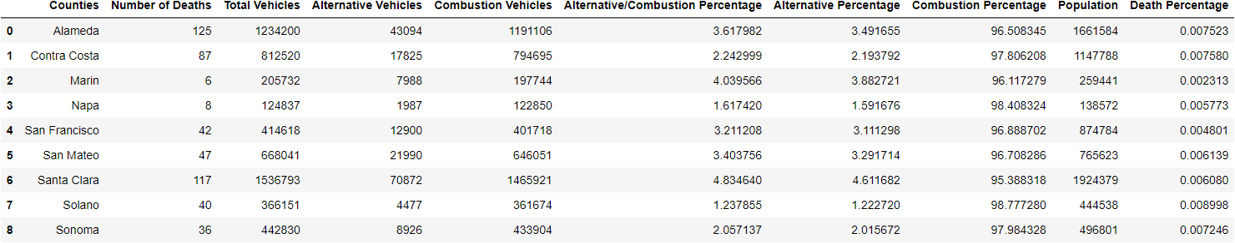
Data Cleaning After
Notes:
All of these led to my final data frame and the corresponding attributes, important things like vehicle counts and ratios, also population bc Death percentage is a better measurement because 36 deaths in Sonoma is more significant that the 117 deaths in santa clara county

Slide 6
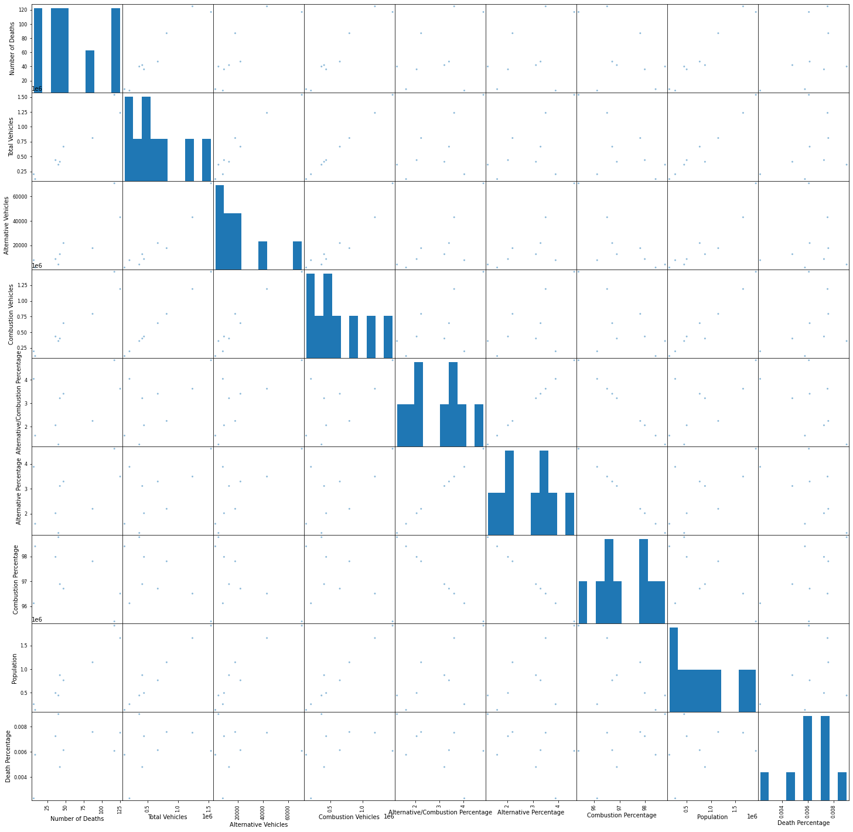
Data Exploration
Pair Wise Plots
Matrix of scatterplots meant to display correlations between attributes
See relationships between 2 variables
Notes:
Created some pairwise plots just to see relationships between the attributes that I had, the diagnol is just a 1:1 comparison of the same attributes so that’s why it looks like that

Slide 7

K-Means Clustering
Unsupervised Machine Learning algorithm: Designated for unlabeled data
Objective: Group similar data points together to discover patterns
Cluster: Collection of data points aggregated because of certain similarities
First ran program with k=9 clusters for the 9 different counties in the Bay Area
Inertia Score determined 3 clusters was the optimal cluster coefficient => 3 triplets of counties were aggregated together based on their similarity
Source: https://towardsdatascience.com/understanding-k-means-clustering-in-machine-learning-6a6e67336aa1
Notes:
If I showed you the code it would probably just be a bunch of gibberish so I can give you an introduction of what this package does from an overhead point of view
Read slide, the image does a better job of probably explaining it then I can cause it gets pretty complex

Slide 8
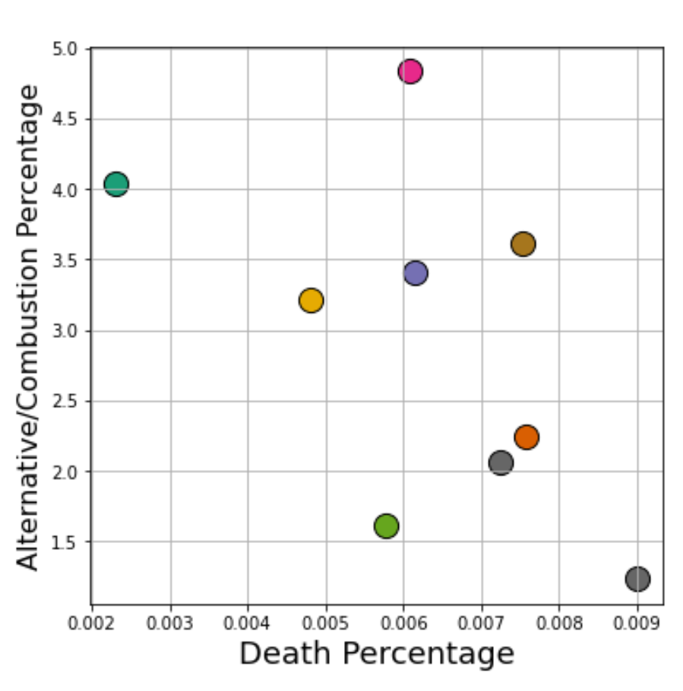
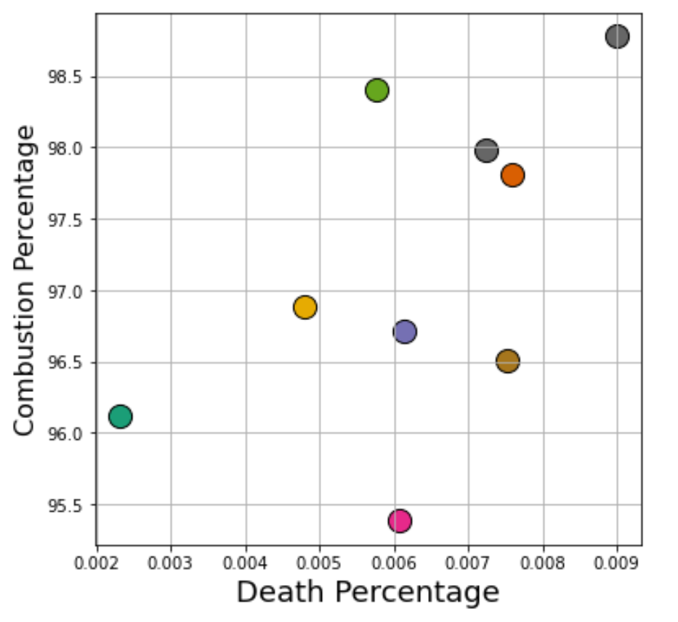
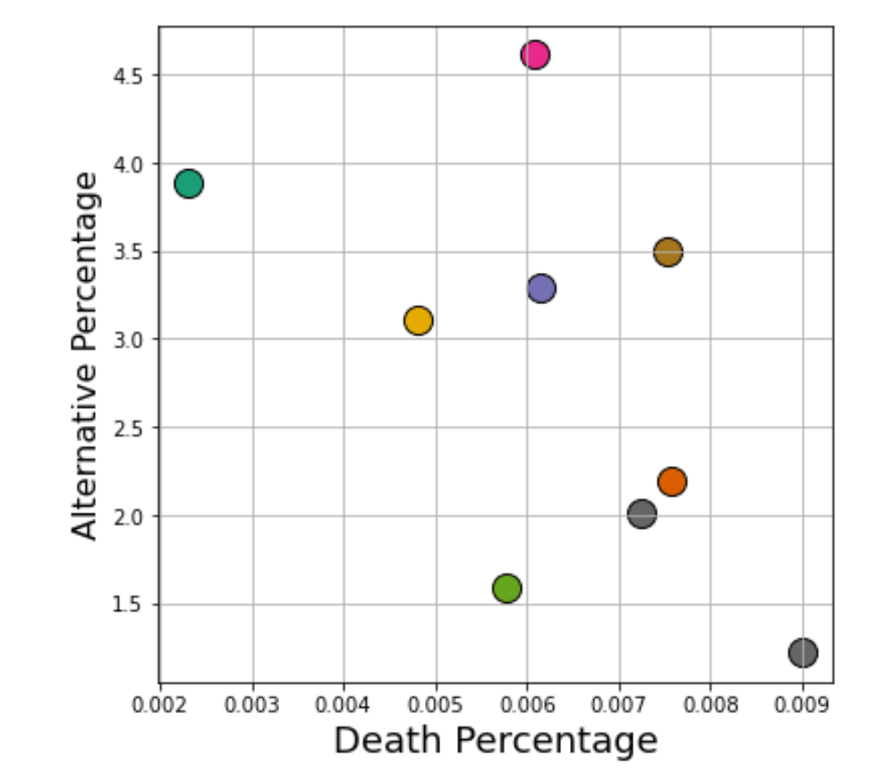
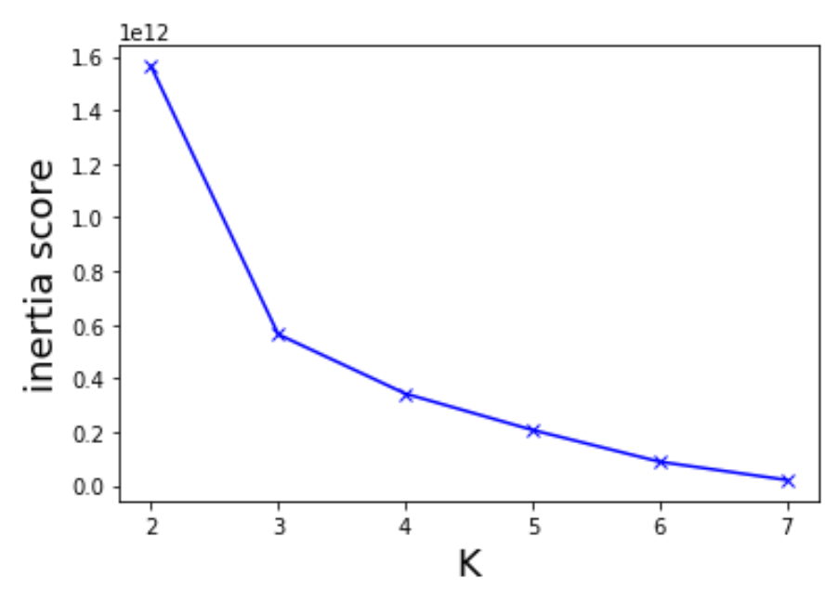
Run 1: K = 9
Notes:
So this was my first run where I had 9 clusters for my 9 counties, but the inertia score found that 3 clusters would be a better aggregated of analysis

Slide 9
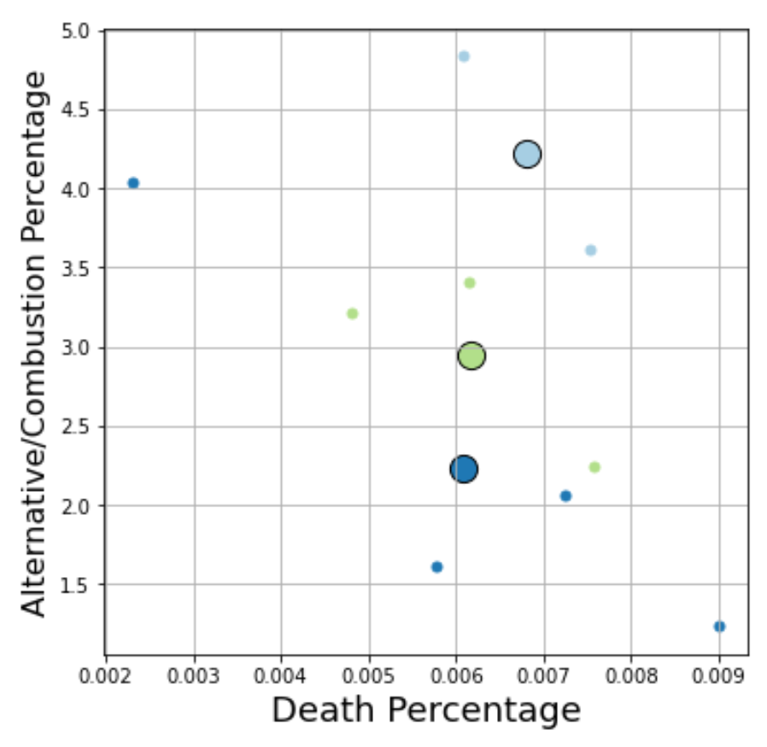
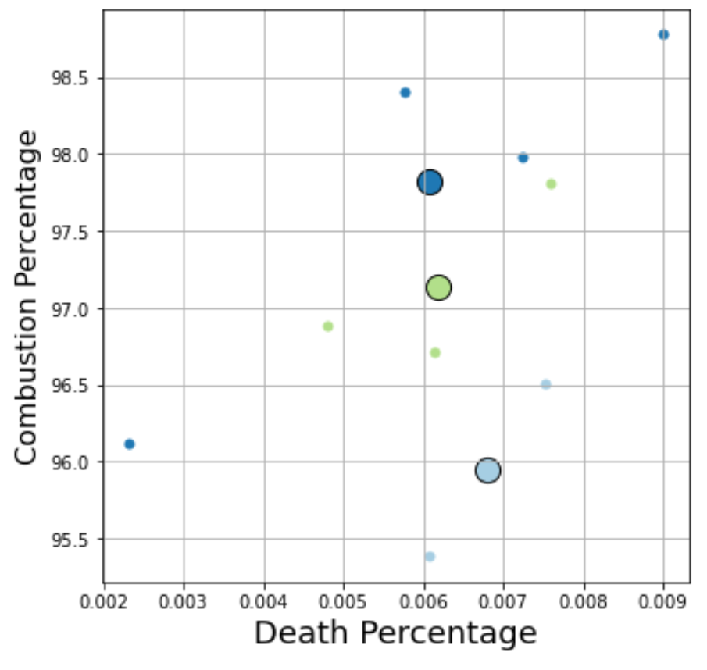
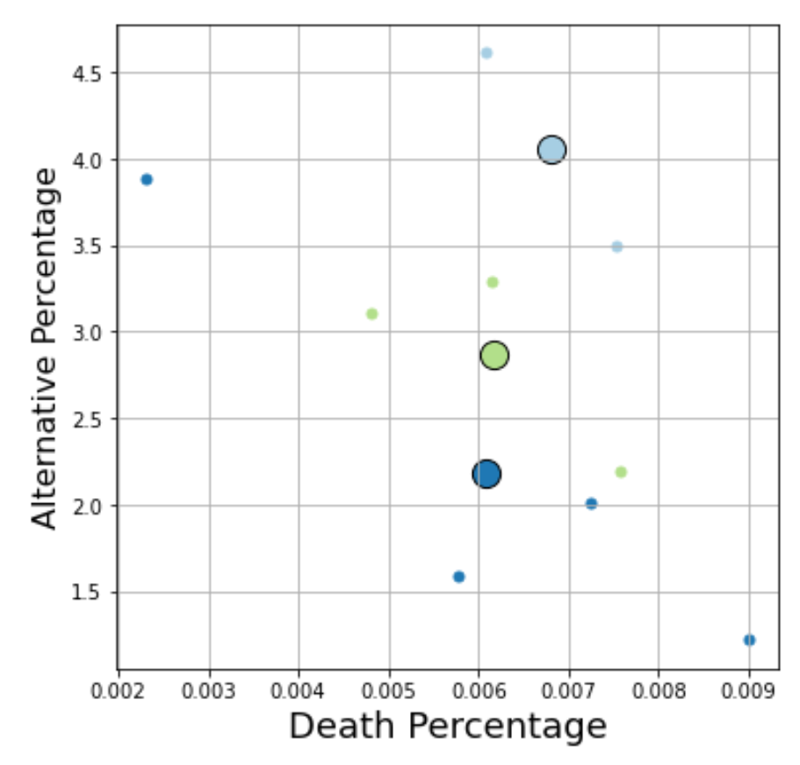
Run 2: K=3
Notes:
These were my final results, contrary to when I first started you can see deaths are attributed at lower combustion vehicle presence and higher alternative led to greater death %, can attribute this to just more cars being in these areas as being a factor, wasn’t too fruitful results tbh but helped me bolster my data cleaning skills, and I think it would be interested to see how this study will fare 15 30 years down the line because theres a ban on manufacturing combustion vehicles in 2025 I believe

Slide 10
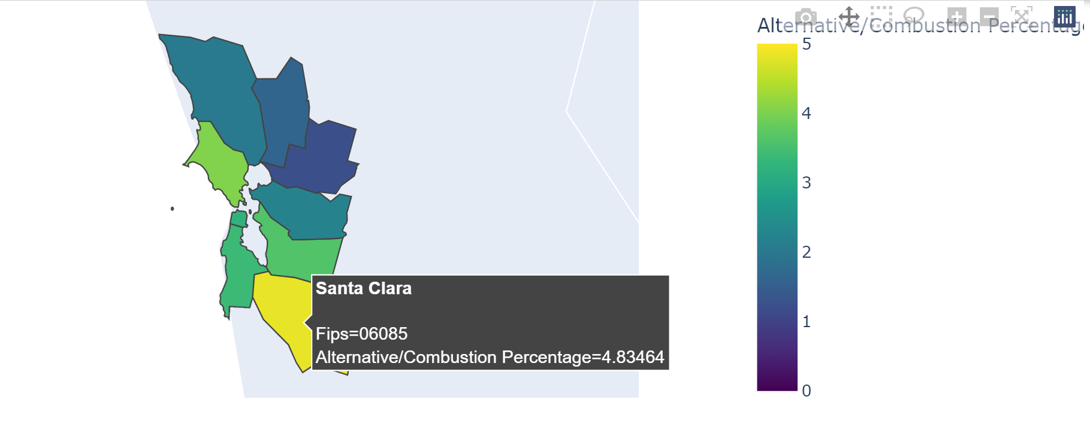
Choropleth Maps: Alternative/Combustion Ratio
Notes:
Some interactive maps I made, I had FIPS ids for each of the counties appended to the dataframe that helped me make these. I haven’t finished my github page ye but they were actually interactive so you could scroll and zoom and see the names and shit it was fun just to see visual comparisons between the data

Slide 11
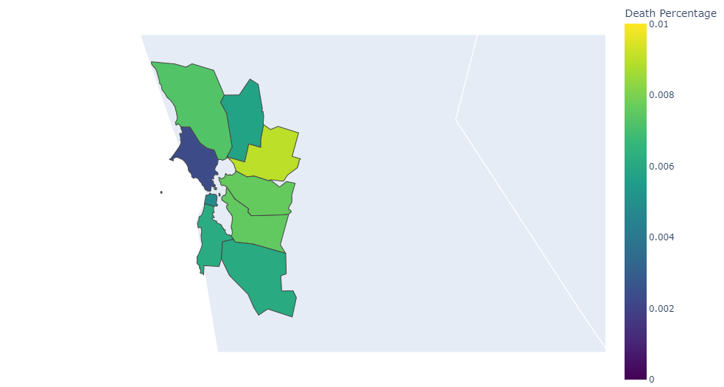
Choropleth Maps: Death % by County

Slide 12
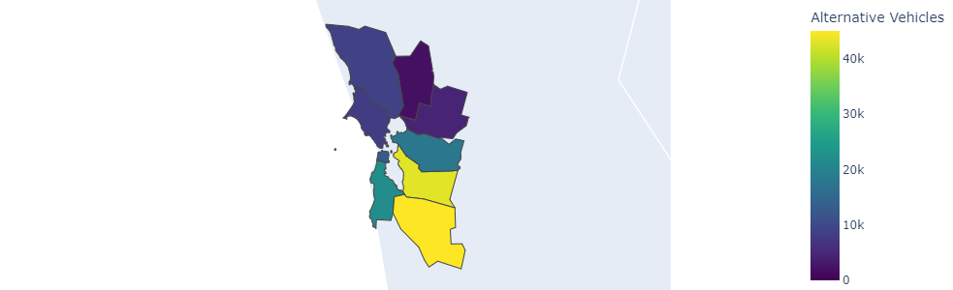
Choropleth Maps: Alternative Vehicles
Notes:
Here you can see this is santa clara most number of cars suburban wealthy county most tech friendly so its just interesting to see It compared to neighboring counties

Slide 13

Thank you for listening!

